Slide 1


Slide 2
LICENSE
This project is licensed under the terms of the GPL.
This program is free software; you can redistribute it and/or modify it under the terms of the GNU General Public License as published by the Free Software Foundation; either version 2 of the License, or (at your option) any later version.
This program is distributed in the hope that it will be useful, but WITHOUT ANY WARRANTY; without even the implied warranty of MERCHANTABILITY or FITNESS FOR A PARTICULAR PURPOSE. See the GNU General Public License for more details.
All product names are property of their respective owners. Such names are used for identification purposes only and are not indicative of endorsement by or of any company, organization, product, or platform.

Slide 3
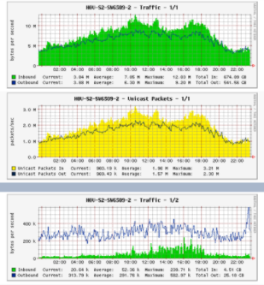
GENERAL INFORMATION
Cacti is an open source, web based network monitoring and graphing tool.
Cacti allows a user to poll services at predetermined intervals and graph the resulting data.
Cacti is written as a group of PHP scripts.

Slide 4
CACTI FEATURES
Main Features: - Open Source
- Complete Free version - SNMP monitoring - Distributed monitoring - Report templates - Security & Authentication

Slide 5
ADVANTAGES
You can measure Availability, Load, Errors and more all with history.
– Cacti can display your router and switch interfaces and their traffic, including all error traffic as well.
– Cacti can measure drive capacity, CPU load (network h/w and servers) and much more. It can
react to conditions and send notifications based on specified ranges.
Graphics
– Allows you to use all the functionality of rrdgraph to define graphics and automate how they are
displayed.
– Allows you to organize information in hierarchical tree structures.
Data Sources
– Permits you to utilize all the functions of rrdcreate and rrdupdate including defining several sources
of information for each RRD file.

Slide 6
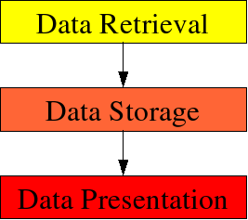
PRINCIPLES OF OPERATION
Data Retrieval:
First task is to retrieve data. Cacti will do so using its Poller. The Poller is executed from the operating system's scheduler, e.g. crontab for Unix flavored OSes.
In current IT installations, we are dealing with lots of devices of different kind, e.g. servers, network equipment, appliances and the like. To retrieve data from remote targets/hosts, cacti will mainly use the Simple Network Management Protocol SNMP. Thus, all devices capable of using SNMP will be eligible to be monitored by cacti.

Slide 7

PRINCIPLES OF OPERATION
Data Storage
There are lots of different approaches for this task. Some may use an (SQL) database, others flat files. Cacti uses RRDTool to store data.
RRD is the acronym for Round Robin Database. RRD is a system to store and display time-series data (i.e. network bandwidth, machine-room temperature, server load average). It stores the data in a very compact way that will not expand over time, and it can create beautiful graphs. This keeps storage requirements at bay.
Likewise, rrdtool will perform some specific tasks. It performs consolidation to combine raw data (a primary data point in rrdtool lingo) to consolidated data (a consolidated data point). This way, historical data is compressed to save space. rrdtool knows different consolidation functions: AVERAGE, MAXIMUM, MINIMUM and LAST.

Slide 8
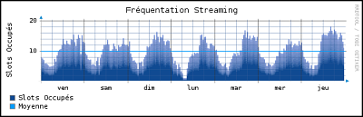
PRINCIPLES OF OPERATION
Data Presentation
One of the most appreciated features of RRDTool is the built-in graphing function. This comes in useful when combining this with some commonly used webserver. Such, it is possible to access the graphs from merely any browser on any plattform.
Graphing can be done in very different ways. It is possible, to graph one or many items in one graph. Autoscaling is supported and logarithmic y-axis as well. You may stack items onto another and print pretty legends denoting characteristics such as minimum, average, maximum and lots more.

Slide 9
SPINE
Spine, formerly Cactid, is a poller for Cacti that primarily strives to be as fast as possible. For this reason it is written in native C, makes use of POSIX threads, and is linked directly against the net-snmp library for minmumal SNMP polling overhead. Spine is a replacement for the default cmd.php poller so you must decide if using Spine makes sense for your installation.
The poller you use has to poll data for all of your graphs within a 300 second time window. If you find that cmd.php's runtime approaches or exceeds 300 seconds, you should consider switching to Spine. You should also try increasing the "Maximum Concurrent Poller Processes" setting before totally giving up on cmd.php.
To determine how long cmd.php is taking to execute, run the following command inside of your Cacti directory:
$ php poller.php

Slide 10
DISADVANTAGES
Configuring Interfaces via the web interface is tedious
Use provided command-line scripts instead
Upgrading versions difficult if installed from source.

